Slide 1
COMP 7212: Operating/Distributed Systems
Chapter 5: Naming
Dr. Myounggyu Won
“Names are used to share resources, to uniquely identify entities, to refer to locations,
and many more.”
“Three different, important ways that names are used in distributed systems are discussed.”
Reference: Distributed Systems: Principles and Paradigms (3rd Edition)

Slide 2
Basic
A name in a distributed system is a string of bits or characters that is used to refer to virtually anything in distributed systems (e.g., hosts, printers, disks, files, processes, messages, network connections, etc.)

Slide 3
Outline
Flat Naming
  Simple solutions
  Home-based approaches
  Distributed hash tables
Structured Naming
  Name spaces
  Name resolution
  Implementation of a name space
Attribute-Based Naming
  Directory services
  Hierarchical implementations
  Decentralized implementations

Slide 4
Flat Naming
“Identifiers (simple random bit strings) are unstructured (or flat names).
Take a look how flat names are resolved, i.e., how do we locate an entity
with an identifier.”

Slide 5
Simple Solutions (1/2)
Problem: how to locate an entity with flat names
  Flat names do not contain any information that can be used to locate an entity!
Two simple solutions
  Broadcasting
    A message containing the identifier of the entity is broadcast to each machine and each machine is requested to check whether it has that entity
    Becomes inefficient as the network size grows
      A possible solution to address this problem is to use multicasting

Slide 6
Simple Solutions (2/2)
Forwarding pointers
  When an entity moves from A to B, it leaves behind at A a reference to its new location at B
  The client can locate the current entity by following the pointer(s)
  Drawbacks
    The chain can be so long – high storage cost
      All intermediate nodes have to maintain the information on the chain (pointers)
    Vulnerability of broken links

Slide 7
Home-based Approaches
A popular approach to support mobile entities in large-scale networks is to use a home agent
  The home agent keeps track of the current location of an entity (even if it has moved to a different location).
Example: mobile IP
  Each mobile host uses a fixed IP address
  All communication to that IP address is initially directed to the mobile host’s home agent
  A care-of address (a temporary address of the mobile device when it moves to another network) is provided by the home agent
  This whole mechanism is hidden for applications
Drawbacks
  Overhead for sending a packet to home agent first
  The home agent should always exist (the single point of failure)

Slide 8
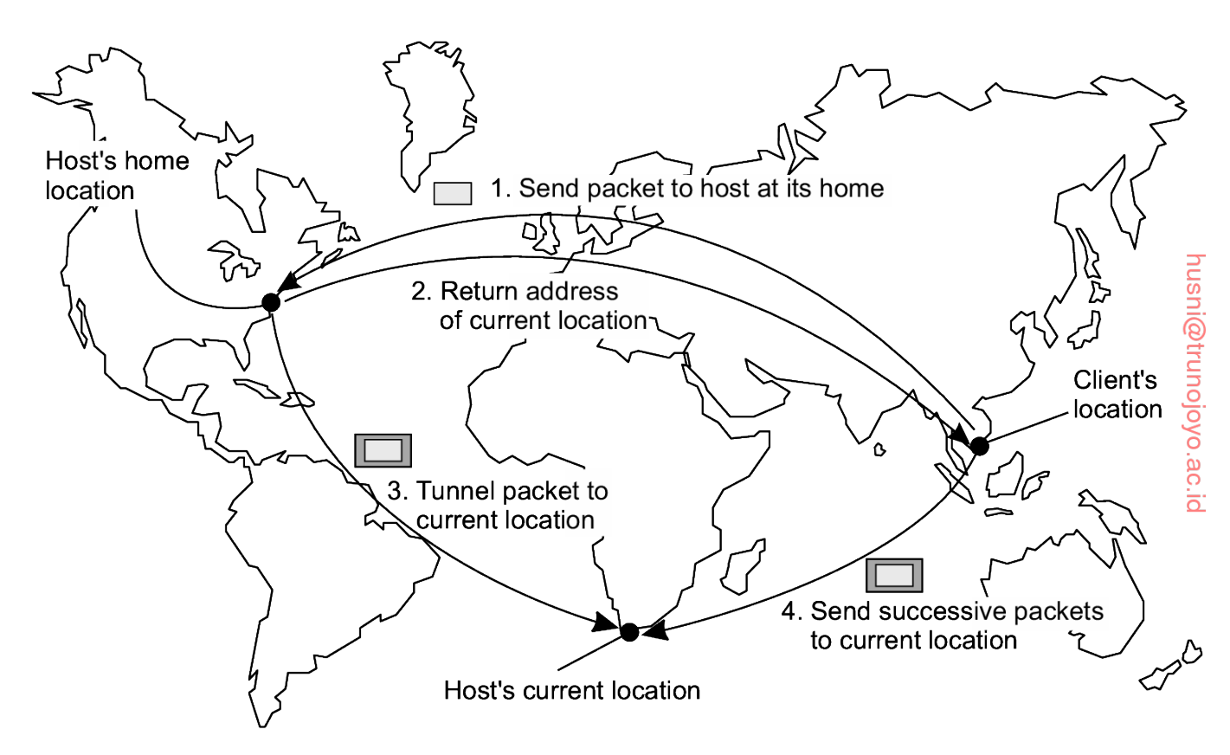

Slide 9
Distributed Hash Tables (1/2)
Distribute the address information to all nodes.
  Each node knows how to reach the requested resource using a name (key)
m-bit identifier space is used to randomly assign identifiers to nodes as well as keys to specific entities (e.g., virtually anything such as files, processes, etc.).
  The key is the name; the identifier is the address
  Q: given a key, find the address of the node having the entity.
Definition: successor of key k
  The node with the smallest identifier id >= k.
  Denoted by succ(k).

Slide 10

Distributed Hash Tables (2/2)
Each node maintains a finger table containing s <= m entries.
Denote the i-th entry of the finger table of node p by FT_{p}[i].
  FT_{p}[i] = succ(p + 2^{i-1} % N).
To look up a key k, node p forwards the request to node q such that
  If predecessor < k < p, q = p.
  Else If , q = FT_{p}[j]. (CASE 1)
  Else if k >= FT_{p}[s], q = FT_{p}[s]. (CASE 2)
  Else if p < k < FT_{p}[1], q = FT_{p}[1]. (CASE 3)

Slide 11
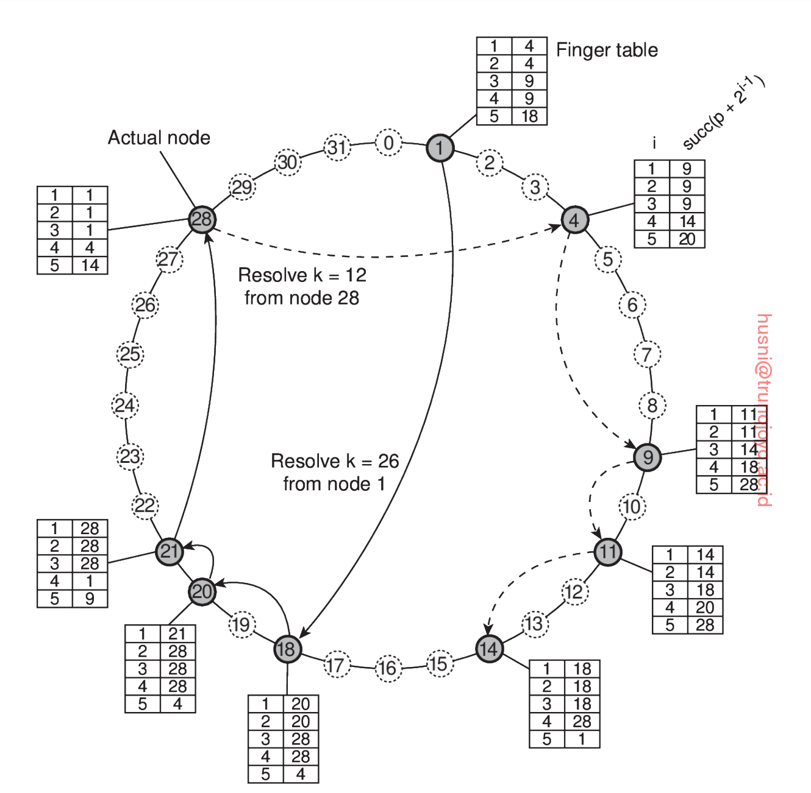
Resolving k=26 from node 1.
(1) 26 >= FT₁[5]
(2) Forward request to node 18 = FT₁[5]
(5) Address of node 28 is
returned to node 1.
(4) Forward to node 21
  If predecessor < k < p, q = p.
  Else If , q = FT_{p}[j]. (CASE 1)
  Else if k >= FT_{p}[s], q = FT_{p}[s]. (CASE 2)
  Else if p < k < FT_{p}[1], q = FT_{p}[1]. (CASE 3)
(3) Forward to node 20 because
FT₁₈[2] <= k < FT₁₈[3].

Slide 12
Structured Naming
“Structured names are composed from simple, human-readable names.
Examine how these names are resolved to addresses.”

Slide 13
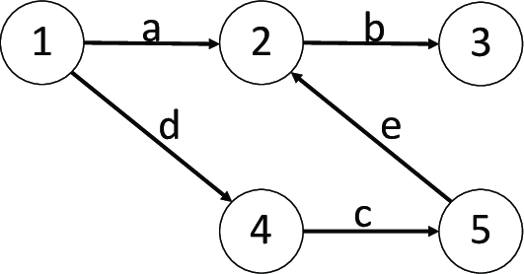
Name Spaces (1/3)
Names are organized into what is called a name space
Name spaces for structured names are represented as a labeled, directed graph

Slide 14
Name Spaces (2/3)
The labeled, directed graph of a name space consists of two types of nodes
  A leaf node represents a named entity and has no outgoing edge
  A directory (source) node has a number of outgoing edges; it stores a table called the directory table consisting of a set of pairs (node identifier, edge label) for its target nodes.
    The directory table indicates which edge is connected to which target node.

Slide 15
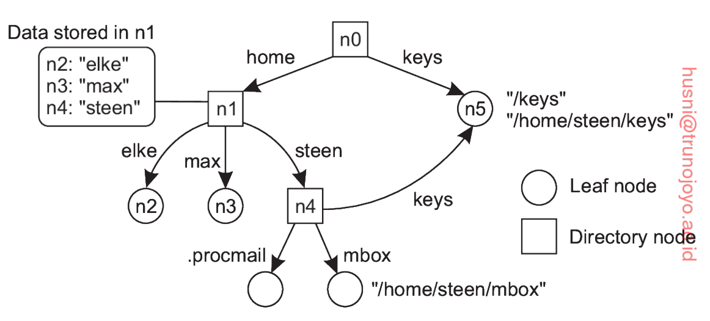
Name Spaces (3/3)
A name is represented as a path in a graph.
And each path in a graph is referred to by a sequence of labels corresponding to the edges on that path

Slide 16
Name Resolution (1/4)
Name resolution
  name (i.e., path) -> address
Consider a path: N:[label₁, label₂, …, label_{n}]
  Starting from node N (usually the root node) of the naming graph where label₁ is looked up in the directory table, which returns the node pointed by the outgoing edge labeled with label₁, …
  Resolution stops at the last node referred to by label_{n} by returning the node’s content
    Here the content is typically an address of the node so the client can access the node’s resources

Slide 17
Name Resolution (2/4)
Closure mechanism
  Name resolution can take place only if we know how (a sequence of labels) and where to start (usually the root node)
  Knowing how and where to start name resolution is generally referred to as a closure mechanism

Slide 18
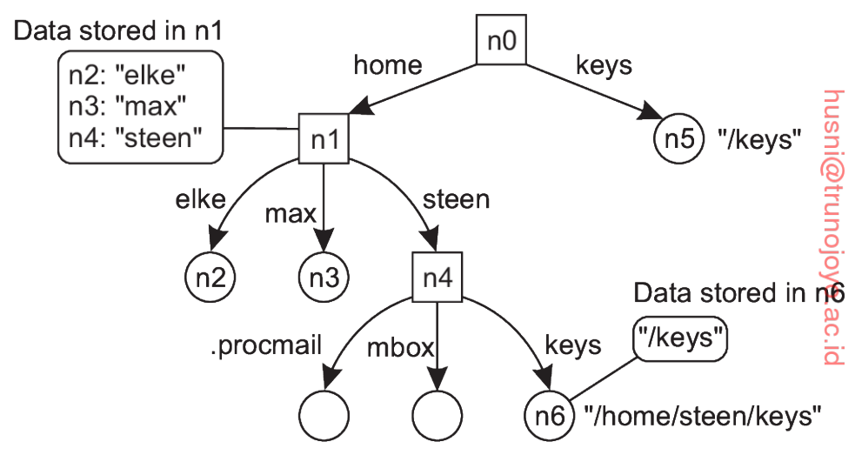
Name Resolution (3/4)
Linking
  Using different names to access the same entity is called linking; An alias is another name for the same entity
  Two different ways of implementing alias
    Allow multiple absolute paths names to refer to the same node
    Instead of storing the address in a leaf node, the leaf node stores an absolute path name for a different node, resulting in accessing the same node with a different name.

Slide 19
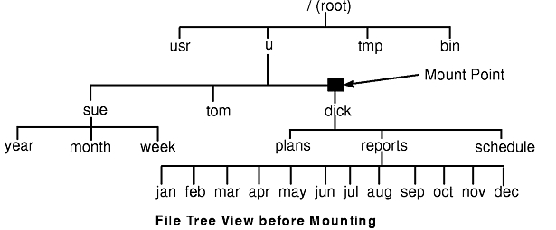
Name Resolution (4/4)
Mounting
  Name resolution can also be used to merge different name spaces; this is called mounting.
  Let a directory node (called the mount point) store the identifier of a directory node (called mounting point) from a different name space.

Slide 20
Implementation of a Name Space (1/3)
A naming service is implemented by name servers
  Name servers perform name resolution, i.e., name -> address
In large-scale distributed systems with many entities spread across a large geographical area, it is necessary to employ multiple name servers
  Each name server is responsible for name resolution at a specific level of a graph.

Slide 21
Implementation of a Name Space (2/3)
Name space distribution
  A name space for a large-scale system is partitioned into logical layers
    Global layer is formed by highest-level nodes (e.g., the root node or its children)
      Characterized by stability in the sense that directory tables are rarely changed.
    Administrational layer is formed by directory nodes that together are managed within a single organization
      Nodes belonging to the same organization
    Managerial layer consists of nodes that may typically change (the directory tables) regularly (e.g., nodes in the local network)

Slide 22
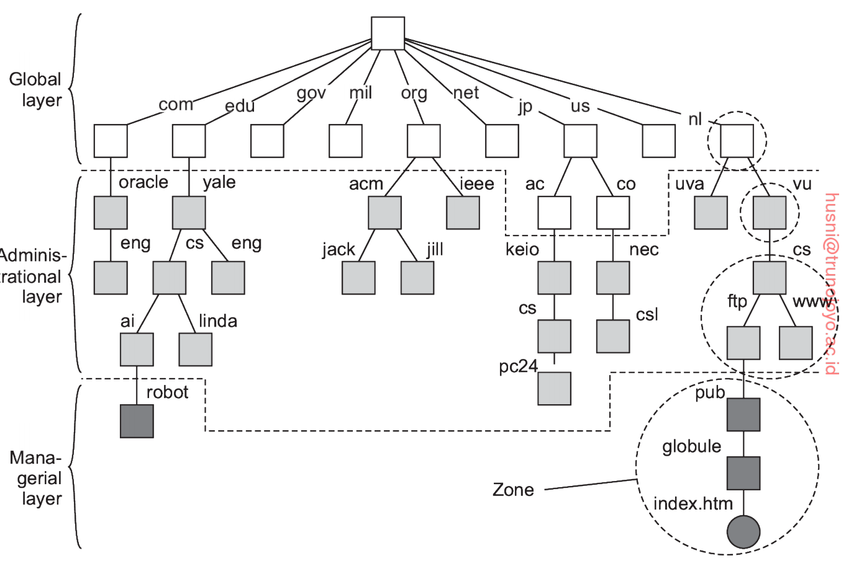
Implementation of a Name Space (3/3)

Slide 23
Implementation of Name Resolution (1/3)
Each client has access to a local name resolver
Two ways of implementation
  In iterative name resolution, a name resolver hands over the complete name to the root name server
  The root server will resolve the name as far as it can (as many labels as possible) and return the result (i.e., the address of the subsequent name server) to the client
  The client passes the remaining path name to that subsequent name server (which was returned by the previous name server)
  That name server will resolve the name as far as it can and return the result (the address of another subsequent name server) to the client
  And so on…

Slide 24
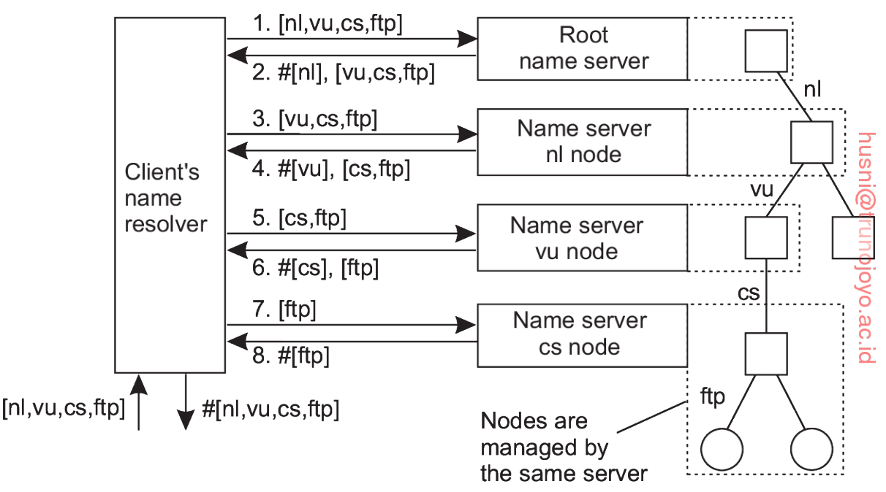
Implementation of Name Resolution (2/3)

Slide 25
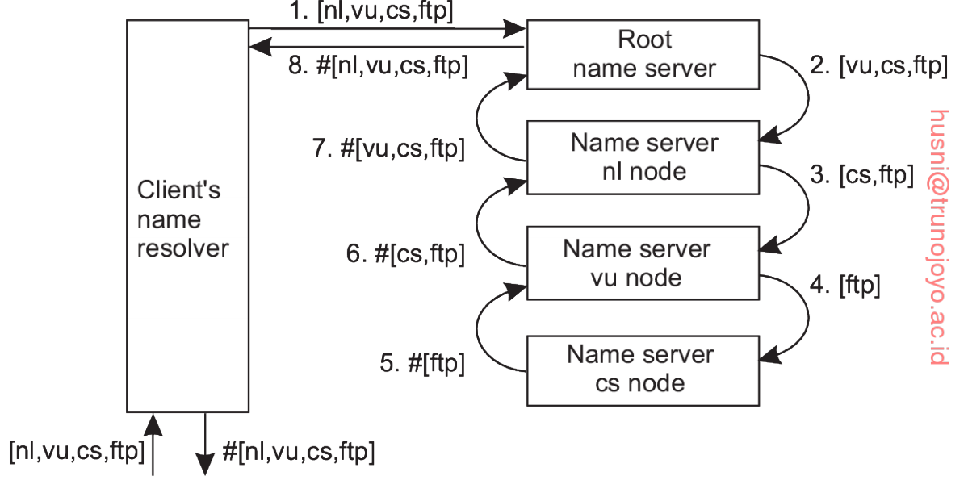
Implementation of Name Resolution (3/3)
Two ways of implementation cont.
  Instead of returning each intermediate result back to the client’s name resolver, with recursive name resolution, a name server passes the result directly to the next name server it finds

Slide 26
Attribute-Based Naming
“Looking up an entity with descriptions of an entity in terms of (attribute, value) is referred to as
attribute-based naming.”
The name of an entity is a set of attribute-value pairs.

Slide 27
Directory Services
Attribute-based naming systems are also known as directory services
  Entities have a set of associated attributes
An entity is assumed to have an associated collection of attributes.
  A sequence of attributes represents a name
  A user provides specific attributes to search for an entities matching the attributes.
  The naming system returns entities that the user is interested in.

Slide 28
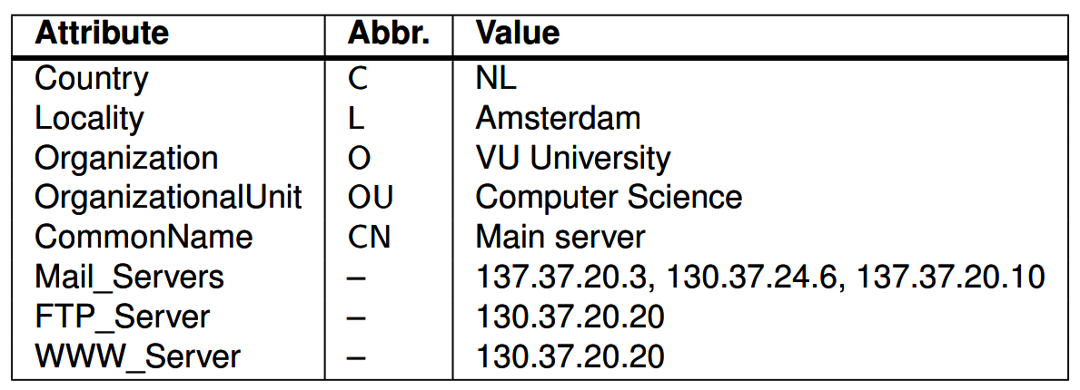
Hierarchical Implementation: LDAP (1/2)
A common approach to implement distributed directory services is to combine structured naming with attribute-based naming
  The attribute-based name space is represented as a labeled, directed tree (no cycle).
  A (directory) node in a directed tree represents an attribute.
  A label of an outgoing edge represents the value of an attribute
  Many of these systems rely on the lightweight directory access protocol (LDAP)
LDAP
  An LDAP directory service consists of a number of records referred to as directory entries
  Each record is made up of a collection of (attribute, value) pairs
An example directory entry.

Slide 29
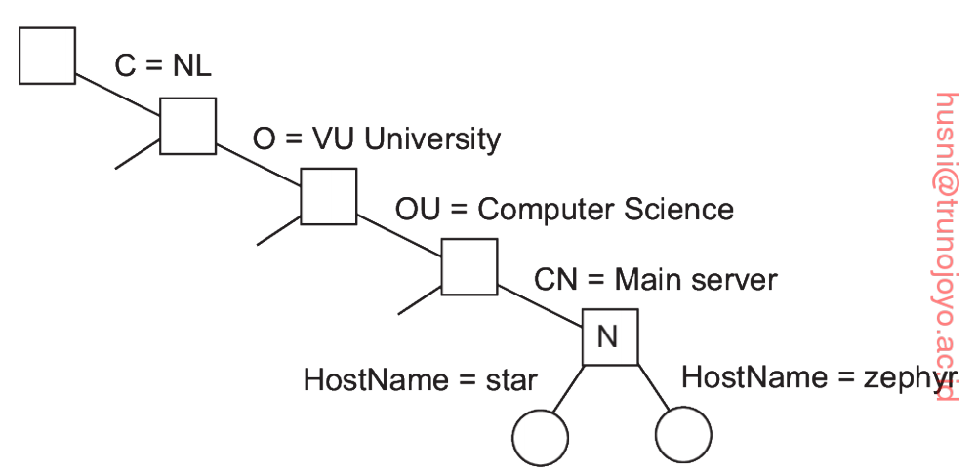
Hierarchical Implementation: LDAP (2/2)
Each record (directory entry) is uniquely named
  A sequence of attributes is used as a unique name.
The globally unique names of records can be represented as a tree called the directory information tree (DIT)
Part of a directory information tree representing two records (star and zephyr)

Slide 30
Decentralized Implementations (1/4)
The centralized implementation method (i.e., maintaining the directory information tree at a centralized server) suffers from the single-point-of-failure problem and the scalability problem.
The idea is to distribute (part) of directory information tree to multiple nodes.
Name resolution for decentralized name server
  A simple solution for name resolution
    Querying every node to see if it contains an entity matching one or more of (attribute, value) pairs
    Inefficient!
  More efficient solution
    Use a small number of designated nodes as index servers which point to entities matching those pairs.

Slide 31
Decentralized Implementations (2/4)
Assume there are d different attributes.
We can deploy an index server for each of the d attributes.
For example, a search query
would be sent to the index servers for Country,
Organization, Organizational Unit, and CommonName,
respectively.
And then, the client can find which entity occurs in all four sets returned by the servers.

Slide 32
Decentralized Implementations (3/4)
Drawbacks of the multiple index server-based implementation method
  Need to contact k index servers -> high communication overhead
  The client needs to process the sets returned by the index servers

Slide 33
Decentralized Implementations (4/4)
Space-filling curves
  The idea is to map the N-dimensional space for the N attributes {a¹, …, a^{N}} into a single dimension, and use a simple hashing technique to distribute the resultant space (i.e., the address information) among index servers.
    Only need to contact a single index server!

